Slide 1
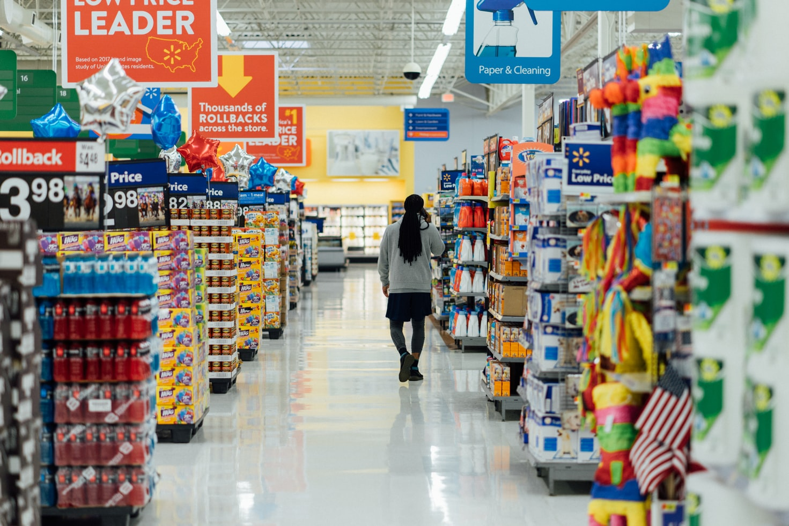
Supermarket Dataset Analysis

Slide 2
INTRODUCTION
A supermarket is self-service shop offering a wide variety of food, beverages and household products, organized into sections. It is larger and has a wider selection than earlier grocery stores, but is smaller and more limited in the range of merchandise than a hypermarket or big-box market.
The growth of supermarkets in most populated cities are increasing and market competitions are also high.
So daily ,weekly, monthly and yearly data analysis required for improvements.

Slide 3
Dataset
This dataset is one of the historical sales of supermarket company which has recorded in 3 different branches for 3 months data. Predictive data analytics methods are easy to apply with this dataset.
Downloaded from Kaggle.com website.
17 columns, 1000 rows.
128 kB of size.

Slide 4
Information's in the dataset
Invoice id: Computer generated sales slip invoice identification number Branch: Branch of supercenter (3 branches are available identified by A, B and C). City: Location of supercenters Customer type: Type of customers, recorded by Members for customers using member card and Normal for without member card. Gender: Gender type of customer Product line: General item categorization groups - Electronic accessories, Fashion accessories, Food and beverages, Health and beauty, Home and lifestyle, Sports and travel Unit price: Price of each product in $ Quantity: Number of products purchased by customer Tax: 5% tax fee for customer buying

Slide 5
Information's in the dataset
Total: Total price including tax Date: Date of purchase (Record available from January 2019 to March 2019) Time: Purchase time (10am to 9pm) Payment: Payment used by customer for purchase (3 methods are available – Cash, Credit card and Ewallet) COGS: Cost of goods sold Gross margin percentage: Gross margin percentage Gross income: Gross income Rating: Customer stratification rating on their overall shopping experience (On a scale of 1 to 10)

Slide 6
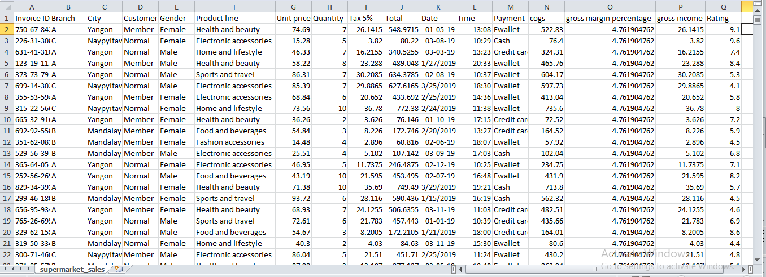
Excel sheet

Slide 7
ADDITIONAL INFoRMATIoN
Gross income = Total sale-cost of good sold
e.g. :- 548.9715 -522.83 = 26.1415
Gross Margin =(Total sale-cost of good sold/Total sale)*100
E.g.:- ((548.9715 -522.83)/ 548.9715)*100 =4.71

Slide 8
objectiveS
Improve customer satisfaction
Helps to building Sales and Profits
Increasing Customer Traffic
Building Customer Loyalty
Improving Department Ratings
Monitor product quality
Predict shopping trends and buyer habits
Demographic and gender purchase analysis

Slide 9
What will you discover from this analysis? Questions?
1.Relation of customers with Super Market 2.Payment methods used in supermarket. 3.Products relation with quantities. 4.Types of product and their sales. 5.Products and their ratings.

Slide 10
Conclusion
finally alighted upon the following conclusions :
There are no missing value in the data set
number of males and females entering the store is almost equal
Females are purchasing more from Fashion accessories and sports and travel. Males are purchasing more from Health & beauty
Yangon city has more number f customers
Home and lifestyle have highest average selling prices
Most of the customers purchase 9 to 10 quantities so increase the number f items and put combo offers more.
type of customer in all branch is almost same
# Most f the customers are using E-Wallet and Cash payment . less usage f credit card. put offers for credit card holders.
Average rating of branch A and C is more than seven and branch B is less than 7.
supermarket makes most of it's sells in 14:00 hrs. local time.
There is no relation between rating and sale

Slide 11
Conclusion
11. average sales of different lines of products. Health and beauty making the highest sales
whereas Fashon accessories making the lowest sales.
12. Home and Lifestyle have highest gross income means largest profit and Fashion accessories have lesser profit .
gives offers and discounts
12. The gross percent spreads with the unit price, i.e for a unit price of higher value, there are a wider range of gross percentages of the commodities in sale
13. Branch C of the supermarket makes the greatest profit
branch of the shop in city named "Naypyitaw", is most profitable
Maximum ratings are in 6.0 which denotes that satisfaction level of the super-market commodities and services are above average and is quite good(considering some spam reviews as well). Many people have also voted for 9.7 as a rating. which says that the services and facilities are good for all branches.
16. From the heatmap we can analyse that tax 5%,total, cogs and gross income are highly correlative
17. Mode of payment doesn't matter at all

